Slide 1
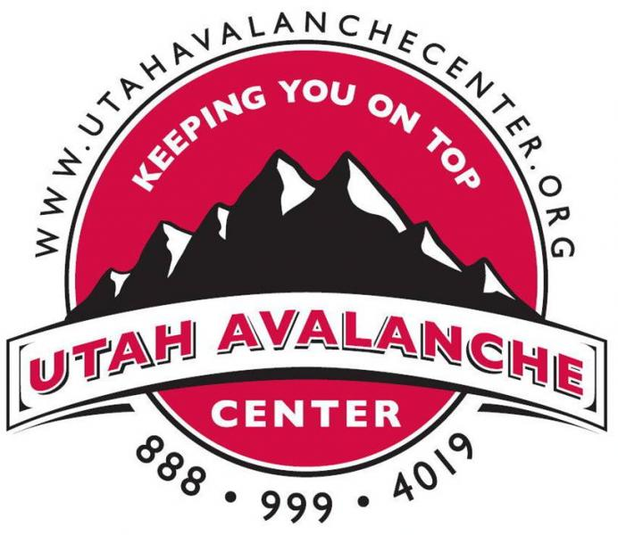
The Friends of the Utah Avalanche Forecast Center
The Utah Avalanche Center is a collaboration between the Forest Service, Utah Avalanche Center and the Friends of the Utah Avalanche center a 501(c)(3) non-profit organization.

Slide 2
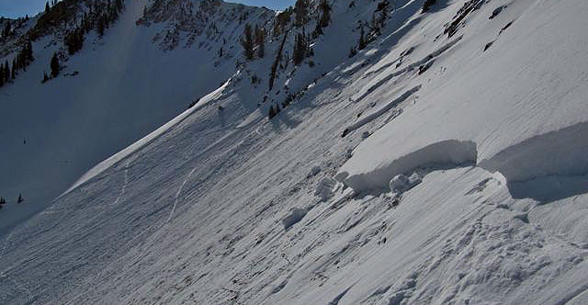
“Our mission is to keep people on top of the Greatest Snow on Earth™.”Website

Slide 3
Mission & Vision
MISSION:
To provide support to the Forest Service Utah Avalanche Center (UAC) in promoting avalanche safety and providing and promoting education to the public through various channels. 2011 Tax Form 990
VISION:
Giving winter backcountry travelers the tools they need to stay alive and have fun in avalanche terrain. We cover the entire state of Utah and have offices in Logan, Salt Lake City, and Moab. ("Who we are | utahavalanchecenter.org")

Slide 4
Employees
The Friends of the Avalanche Forecast Center
Primarily operated and supported by volunteers.
With the exception of two employees.
Executive Director Paul Diegel.
Education and Social Media Coordinator Devin Dwyer.

Slide 5
Programs
Avalanche Forecasting:
Each Day, detailed advisory is distributed by phone message, radio PSAs, email, and website.
Avalanche Awareness:
Know Before You Go-(KBYG):
Basic avalanche awareness presentation, offered in a free one-hour school and group session that is designed for younger users.
Avalanche Education:
Provide lectures and field day avalanche classes at a moderate cost.
Community Resource:
Maintains the most comprehensive avalanche website in the U.S., with daily advisories, video tutorials, field observations, a glossary, media resources, a database of snow profiles, photos, videos, and calendar of events.

Slide 6
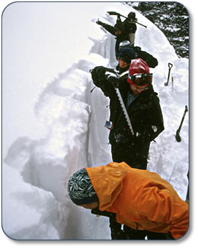
Field Education and workshops

Slide 7
About 2/3 of the funding for the UAC comes from donations, grants, and events.

Slide 8
Issues:
Big snowpack years can create a shortage of resources for The Utah Avalanche Center. On April 3 2011, the (UAC) announced that it had reached the end of its funding and it would be closing for the season. Without their expert information on current avalanche and weather conditions, thousands of backcountry users in Utah face a higher risk of accident, injury or even death due to unstable snow conditions and avalanche. Backcountry.com donated $6,300 to restore and extend backcountry avalanche forecasting through April 24. ("Backcountry.com donation keeps Utah Avalanche Center open", n.d., p. xx)

Slide 9
Accomplishments
In 2013 the FUAC and the Forest Service signed a Memorandum of Understanding to help with frequent confusion by defining the relationship between the to entities.
In 2013 Utah Avalanche Center teamed with Backcountry.com and Garafa, LLC in developing a information and backcountry touring mobile device application.
The UAC implemented a new web design that created a unified look-and-feel for avalanche advisories with other avalanche centers in the region.

Slide 10
Competition
Sierra Avalanche Center
Our mission is to inform and educate the public about backcountry avalanche conditions in the greater Lake Tahoe area.
Colorado Avalanche Information Center
The mission of the CAIC is to provide avalanche information, education and promote research for the protection of life, property and the enhancement of the state’s economy.
The Friends of the Sawtooth Avalanche Center
Our Mission is to support the Sawtooth Avalanche Center and promote life-saving avalanche safety information, education and outreach throughout South Central Idaho communites.

Slide 11
SWOT
Strengths
Historical community support
Adaptive social media
Weaknesses
Repetitive fund raising
Increase in paid employees
Opportunities
Increased backcountry use
Growing outdoor industry in Utah
Threats
Big snow years
A bad economy

Slide 12
References
Retrieved from http://www.guidestar.org/FinDocuments/2012/870/481/2012-870481453-08fa7cec-9.pdf
Retrieved from http://utahavalanchecenter.org/sites/default/files/archive/annual-reports/uac/AnnualReport2012-13.pdf
Backcountry.com donation keeps Utah Avalanche Center open. (n.d.). Retrieved from http://www.powdermag.com/industry-news-and-events/backcountry-com-donation-keeps-utah-avalanche-center-open/
Who we are | utahavalanchecenter.org. (n.d.). Retrieved from http://utahavalanchecenter.org/about/who-we-are

